Slide 1
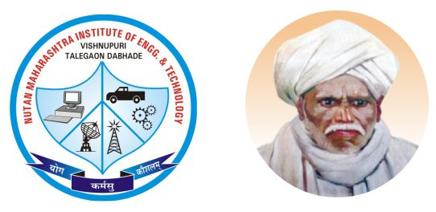

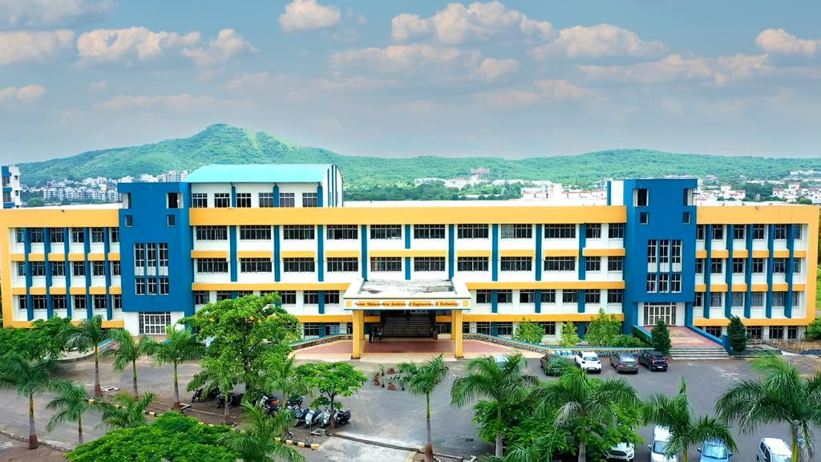

NUTAN MAHARASHTRA INSTITUTE OF ENGINEERING & TECHNOLOGY, PUNE
Nutan Maharashtra Vidya Prasarak Mandal's
Department of Computer Engineering
NBA Accredited
SPPU Project Work Stage – II (410256)
Academic Year 2024-25
https://www.nmiet.edu.in/index.php

Slide 2

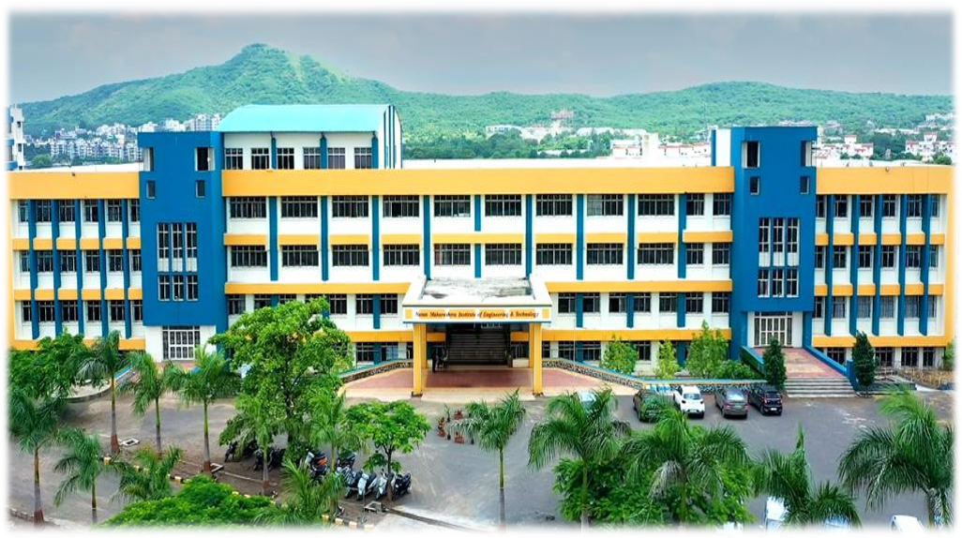
Nutan Maharashtra Vidya Prasarak Mandal's
NUTAN MAHARASHTRA INSTITUTE OF ENGINEERING & TECHNOLOGY, PUNE
Department of Computer Engineering
A
Project Review
on
“Advance surveillance system and suspicious entity detection system based on IOT”
Prepared By
Mr. Nikunj Mahadev Dawari (B400550143)
Mr. Aniket Vijay Ghadage (B400550153)
Mr. Aditya Nandkumar Jaybhaye (B400550170)
Guided by
Prof. Pritam Ahire
PCET’S & NMVPM’S
NUTAN MAHARASHTRA INSTT. OF ENGG. & TECH. Pune
SPPU Project Work Stage – I, A.Y. 2024-25
https://www.nmiet.edu.in

Slide 3
Nutan Maharashtra Vidya Prasarak Mandal's
NUTAN MAHARASHTRA INSTITUTE OF ENGINEERING & TECHNOLOGY, PUNE
Department of Computer Engineering
Contents
Project Title
Problem Domain
Existing System
Problem Statement
Scope & objective
Literature Survey
Review Papers
Proposed System
SPPU Project Work Stage – I, A.Y. 2024-25
https://www.nmiet.edu.in

Slide 4
Nutan Maharashtra Vidya Prasarak Mandal's
NUTAN MAHARASHTRA INSTITUTE OF ENGINEERING & TECHNOLOGY, PUNE
Department of Computer Engineering
Contents
9. System Design
10. Implementation 11. Project Testing Result
12. Advantages
13. Disadvantages
14. Conclusion
15. Future Scope
16. References
SPPU Project Work Stage – I, A.Y. 2024-25
https://www.nmiet.edu.in

Slide 5
1. Project Title:
Nutan Maharashtra Vidya Prasarak Mandal's
NUTAN MAHARASHTRA INSTITUTE OF ENGINEERING & TECHNOLOGY, PUNE
Department of Computer Engineering
Advance surveillance system and suspicious entity detection system based on IOT
SPPU Project Work Stage – I, A.Y. 2024-25
https://www.nmiet.edu.in

Slide 6
2. Problem Domain:
Nutan Maharashtra Vidya Prasarak Mandal's
NUTAN MAHARASHTRA INSTITUTE OF ENGINEERING & TECHNOLOGY, PUNE
Department of Computer Engineering
The goal is to design and develop an intelligent surveillance system capable of detecting suspicious activities or entities in real-time, leveraging IoT sensors, devices, and advanced data analytics.
SPPU Project Work Stage – I, A.Y. 2024-25
https://www.nmiet.edu.in

Slide 7
3. Existing system
Nutan Maharashtra Vidya Prasarak Mandal's
NUTAN MAHARASHTRA INSTITUTE OF ENGINEERING & TECHNOLOGY, PUNE
Department of Computer Engineering
Limited Accuracy in Suspicious Behavior Detection
Many existing surveillance systems primarily rely on basic motion detection or simple image recognition algorithms.
Current systems don’t have the capability to predict or analyze historical trends to prevent incidents before they occur, potentially allowing threats to develop into serious incidents.
Current systems often fail to adapt to challenging or changing environmental conditions, missing important data that could help identify potential threats.
Cloud-based systems suffer from inherent delays, reducing the system's effectiveness in real-time response scenarios and leading to slower security interventions.
SPPU Project Work Stage – I, A.Y. 2024-25
https://www.nmiet.edu.in

Slide 8
4. Problem Statement
Nutan Maharashtra Vidya Prasarak Mandal's
NUTAN MAHARASHTRA INSTITUTE OF ENGINEERING & TECHNOLOGY, PUNE
Department of Computer Engineering
Traditional surveillance systems often rely on manual monitoring, which is time consuming and prone to errors. The problem this project addresses is the development of a reliable IoT-based system that can automatically detect and alert authorities about suspicious entities in real-time, reducing response times and enhancing security.
SPPU Project Work Stage – I, A.Y. 2024-25
https://www.nmiet.edu.in

Slide 9
5. Scope & Objective
Nutan Maharashtra Vidya Prasarak Mandal's
NUTAN MAHARASHTRA INSTITUTE OF ENGINEERING & TECHNOLOGY, PUNE
Department of Computer Engineering
5.1 Scope:
The need for advanced, automated surveillance solutions in military security arises from the high-stakes nature of defense operations. Traditional surveillance methods, which rely heavily on human monitoring, are limited by human attention span, response time, and coverage area. These limitations can lead to delayed reactions, missed threats, and increased vulnerability in sensitive military zones. Deep learning and IoT technologies address these gaps by enabling automated, accurate, and real-time threat detection.
SPPU Project Work Stage – I, A.Y. 2024-25
https://www.nmiet.edu.in

Slide 10
Nutan Maharashtra Vidya Prasarak Mandal's
NUTAN MAHARASHTRA INSTITUTE OF ENGINEERING & TECHNOLOGY, PUNE
Department of Computer Engineering
5.2 Objective:
The primary objective of this project is to enhance army security by developing a Surveillance Detection System that effectively monitors and detects potential threats in real-time. The system aims to identify authorized personnel and distinguish them from unauthorized individuals in critical areas. The key challenges to address include:
1. Accurate Detection: The system must accurately identify soldiers and differentiate between authorized and unauthorized individuals based on uniform color and other identifying features.
2. Real-time Monitoring: The system needs to provide immediate alerts to the control room and activate alarms upon detecting unauthorized personnel, ensuring a prompt response to potential threats.
3. Integration of IoT Components: The solution should seamlessly integrate hardware components like cameras and IoT devices (e.g., NodeMCU Wi-Fi module) for efficient data transmission and alert mechanisms
SPPU Project Work Stage – I, A.Y. 2024-25
https://www.nmiet.edu.in

Slide 11
Nutan Maharashtra Vidya Prasarak Mandal's
NUTAN MAHARASHTRA INSTITUTE OF ENGINEERING & TECHNOLOGY, PUNE
Department of Computer Engineering
4. High Performance: The system must maintain a high level of accuracy in object detection and recognition (targeting above 90% accuracy) while keeping latency to a minimum (around 1-2 seconds) for timely threat response.
5. User-Friendly Interface: The monitoring interface should be intuitive, allowing security personnel to easily interpret alerts and manage responses effectively.
SPPU Project Work Stage – I, A.Y. 2024-25
https://www.nmiet.edu.in

Slide 12
6. Literature Survey
Nutan Maharashtra Vidya Prasarak Mandal's
NUTAN MAHARASHTRA INSTITUTE OF ENGINEERING & TECHNOLOGY, PUNE
Department of Computer Engineering
6.1 Reference Paper -1:
Title: “Color-Based Recognition of Soldiers’ Uniforms for Smart Surveillance”
Authors: Zheng et al
Journal: International Journal of AI.
Year: 2020
6.1.1 Description:
Purpose: Uses deep learning for identifying soldiers based on uniform color and design.
Technology Used: Color-based classification methods to distinguish between friendly and enemy forces.
SPPU Project Work Stage – I, A.Y. 2024-25
https://www.nmiet.edu.in

Slide 13
Nutan Maharashtra Vidya Prasarak Mandal's
NUTAN MAHARASHTRA INSTITUTE OF ENGINEERING & TECHNOLOGY, PUNE
Department of Computer Engineering
Key Features:
-Uniform Analysis: Identifies individuals based on uniform color and patterns, helpful in military contexts.
-Detection Accuracy: Reduces risks of infiltration by unauthorized personnel.
Significance:
-Supports enhanced detection accuracy using uniform-based recognition for military security.
SPPU Project Work Stage – I, A.Y. 2024-25
https://www.nmiet.edu.in

Slide 14
6.1.2 Gap Analysis/Result:
Nutan Maharashtra Vidya Prasarak Mandal's
NUTAN MAHARASHTRA INSTITUTE OF ENGINEERING & TECHNOLOGY, PUNE
Department of Computer Engineering
Focuses on uniform color and pattern recognition; lacks consideration for complex backgrounds and variable lighting.
Limited adaptability in diverse military settings with changing environmental factors.
Uniform analysis helped to reduce infiltration risks by distinguishing uniforms accurately.
Our project integrates this approach to ensure accuracy in identifying personnel, thus reducing risks associated with unauthorized access
SPPU Project Work Stage – I, A.Y. 2024-25
https://www.nmiet.edu.in

Slide 15
Nutan Maharashtra Vidya Prasarak Mandal's
NUTAN MAHARASHTRA INSTITUTE OF ENGINEERING & TECHNOLOGY, PUNE
Department of Computer Engineering
6.2 Reference Paper -2:
Title:“ IoT-Based Surveillance System for Intrusion Detection Using Deep Learning ”
Authors: Anwar et al.
Journal: Journal of IoT Security.
Year: 2020
6.2.1 Description:
Purpose: Uses deep learning for identifying soldiers based on uniform color and design.
Technology Used: Color-based classification methods to distinguish between friendly and enemy forces.
SPPU Project Work Stage – I, A.Y. 2024-25
https://www.nmiet.edu.in

Slide 16
Nutan Maharashtra Vidya Prasarak Mandal's
NUTAN MAHARASHTRA INSTITUTE OF ENGINEERING & TECHNOLOGY, PUNE
Department of Computer Engineering
Key Features:
-Uniform Analysis: Identifies individuals based on uniform color and patterns, helpful in military contexts.
-Detection Accuracy: Reduces risks of infiltration by unauthorized personnel.
Significance:
-Supports enhanced detection accuracy using uniform-based recognition for military security.
SPPU Project Work Stage – I, A.Y. 2024-25
https://www.nmiet.edu.in

Slide 17
6.2.2 Gap Analysis/Result:
Nutan Maharashtra Vidya Prasarak Mandal's
NUTAN MAHARASHTRA INSTITUTE OF ENGINEERING & TECHNOLOGY, PUNE
Department of Computer Engineering
Tested mainly in civilian security settings; performance under high-stakes military conditions unverified.
Does not address the system’s reliability in hostile or remote environments, where interference may be present.
Additional testing needed in challenging defense contexts to confirm robustness and effectiveness.
Our system builds on these findings by providing real-time alerts and updates to enhance situational awareness in areas like government and private sectors."
SPPU Project Work Stage – I, A.Y. 2024-25
https://www.nmiet.edu.in

Slide 18
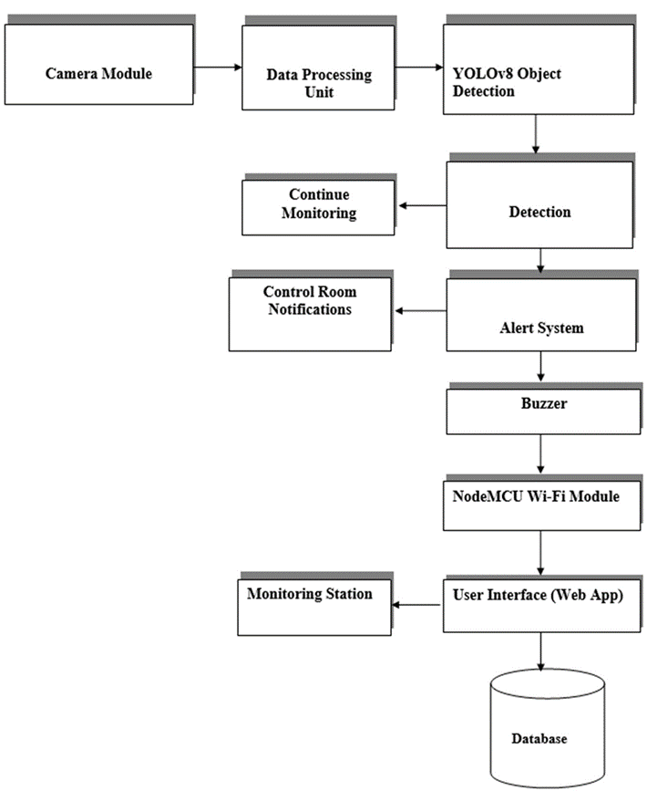
8. Proposed System
Nutan Maharashtra Vidya Prasarak Mandal's
NUTAN MAHARASHTRA INSTITUTE OF ENGINEERING & TECHNOLOGY, PUNE
Department of Computer Engineering
SPPU Project Work Stage – I, A.Y. 2024-25
https://www.nmiet.edu.in

Slide 19
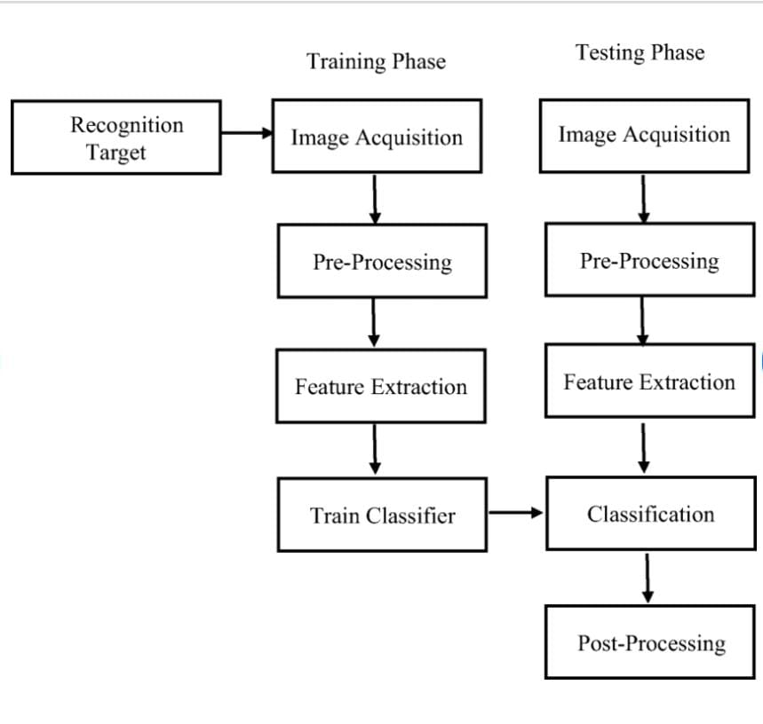
9. System Design
Nutan Maharashtra Vidya Prasarak Mandal's
NUTAN MAHARASHTRA INSTITUTE OF ENGINEERING & TECHNOLOGY, PUNE
Department of Computer Engineering
SPPU Project Work Stage – I, A.Y. 2024-25
https://www.nmiet.edu.in

Slide 20
Methodology
Nutan Maharashtra Vidya Prasarak Mandal's
NUTAN MAHARASHTRA INSTITUTE OF ENGINEERING & TECHNOLOGY, PUNE
Department of Computer Engineering
1 Input Data Acquisition:
- Captures real-time video and image data via cameras and sensors.
- Focuses on uniform detection and people count.
2. Preprocessing:
- Uses image processing techniques (e.g., object detection) to identify individuals.
- Detects uniforms using pattern recognition or machine learning algorithms.
3. Feature Extraction:
- Extracts uniform patterns (color, texture) to classify people.
- Tracks the count of individuals in the surveillance area.
SPPU Project Work Stage – I, A.Y. 2024-25
https://www.nmiet.edu.in

Slide 21
Nutan Maharashtra Vidya Prasarak Mandal's
NUTAN MAHARASHTRA INSTITUTE OF ENGINEERING & TECHNOLOGY, PUNE
Department of Computer Engineering
4. Classification and Detection:
- Case 1: Detects unknown persons not matching uniform.
- Case 2: Alerts on any unexpected increase in people count.
- Case 3: Detects any person in “no patrol mode.”
5. Control System Interaction:
- Real-time alerts sent to the control room (laptop).
- Adjusts detection modes and authorized personnel count.
SPPU Project Work Stage – I, A.Y. 2024-25
https://www.nmiet.edu.in

Slide 22
Algorithm:
Nutan Maharashtra Vidya Prasarak Mandal's
NUTAN MAHARASHTRA INSTITUTE OF ENGINEERING & TECHNOLOGY, PUNE
Department of Computer Engineering
YOLOv8 (You Only Look Once)
A fast and accurate real-time object detection system.
Single Shot MultiBox Detector (SSD)
Balances speed and accuracy for detecting multiple objects.
Convolutional Neural Networks (CNNs)
Effective for image classification tasks; foundational for other models.
Faster R-CNN
Combines region proposal networks with CNNs for enhanced precision.
Transfer Learning
Use pre-trained models like VGG16 and ResNet to improve training efficiency.
Training Process
Data Preparation: Collect and label images of various uniforms.
Model Training: Utilize frameworks such as TensorFlow or PyTorch.
Hyperparameter Tuning: Optimize learning rate, batch size, and epochs.
Validation and Testing: Assess model performance on unseen data and iterate for improvement
SPPU Project Work Stage – I, A.Y. 2024-25
https://www.nmiet.edu.in

Slide 23
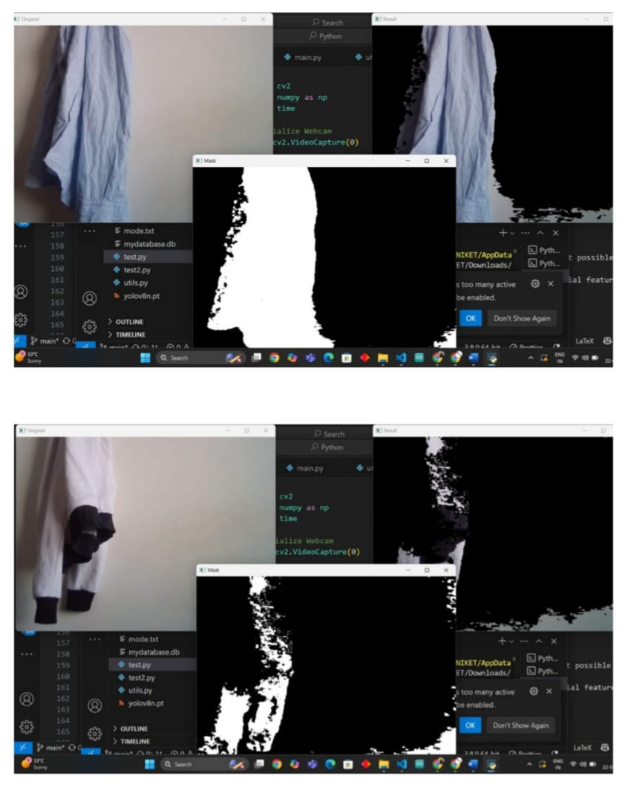
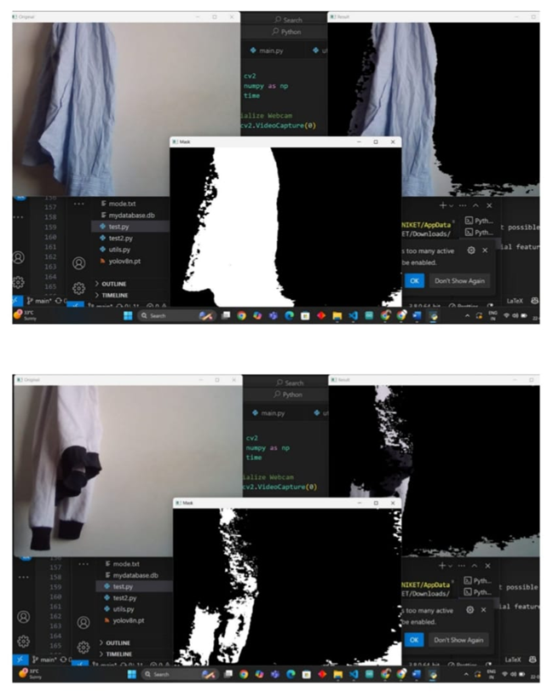
10. Implementation
Nutan Maharashtra Vidya Prasarak Mandal's
NUTAN MAHARASHTRA INSTITUTE OF ENGINEERING & TECHNOLOGY, PUNE
Department of Computer Engineering
SPPU Project Work Stage – I, A.Y. 2024-25
https://www.nmiet.edu.in

Slide 24

Nutan Maharashtra Vidya Prasarak Mandal's
NUTAN MAHARASHTRA INSTITUTE OF ENGINEERING & TECHNOLOGY, PUNE
Department of Computer Engineering
SPPU Project Work Stage – I, A.Y. 2024-25
https://www.nmiet.edu.in

Slide 25
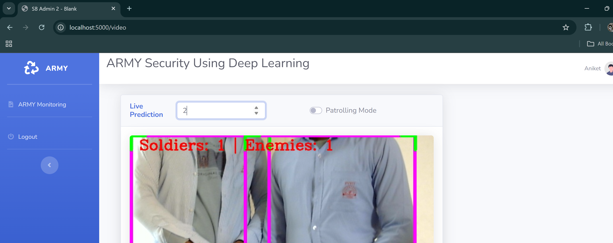
Nutan Maharashtra Vidya Prasarak Mandal's
NUTAN MAHARASHTRA INSTITUTE OF ENGINEERING & TECHNOLOGY, PUNE
Department of Computer Engineering
SPPU Project Work Stage – I, A.Y. 2024-25
https://www.nmiet.edu.in

Slide 26
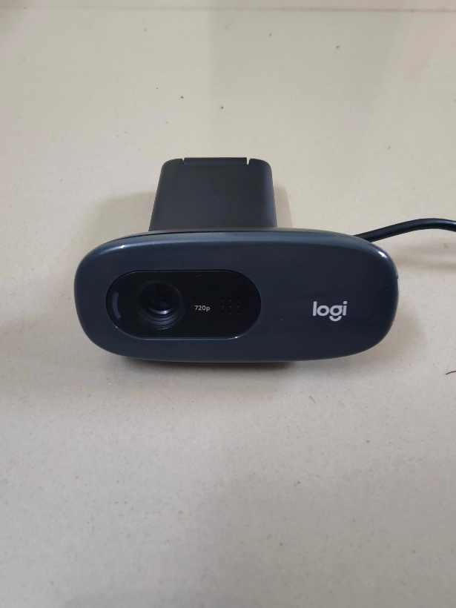
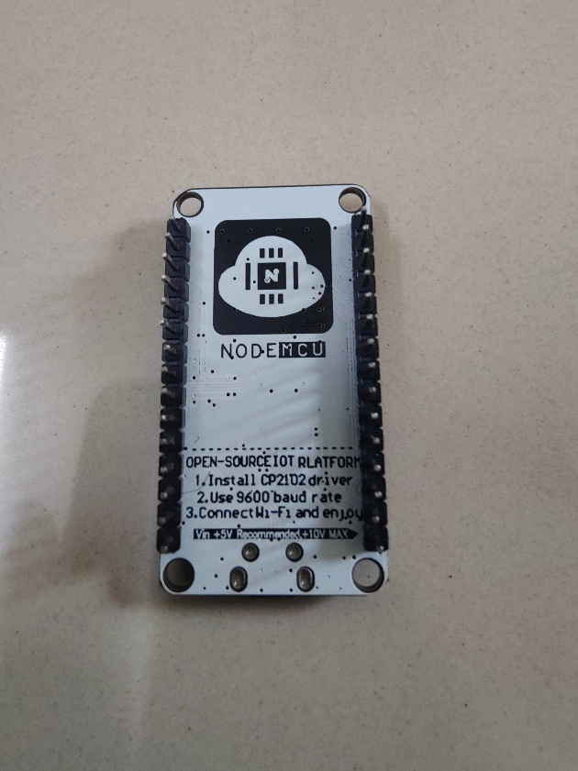
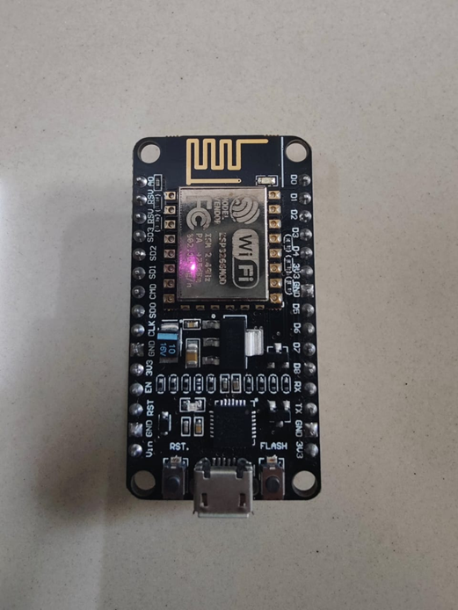
Nutan Maharashtra Vidya Prasarak Mandal's
NUTAN MAHARASHTRA INSTITUTE OF ENGINEERING & TECHNOLOGY, PUNE
Department of Computer Engineering
High Definition Camera (HD cam)
Node MCU WiFi Module (Front)
Node MCU WiFi Module (Back)
SPPU Project Work Stage – I, A.Y. 2024-25
https://www.nmiet.edu.in

Slide 27
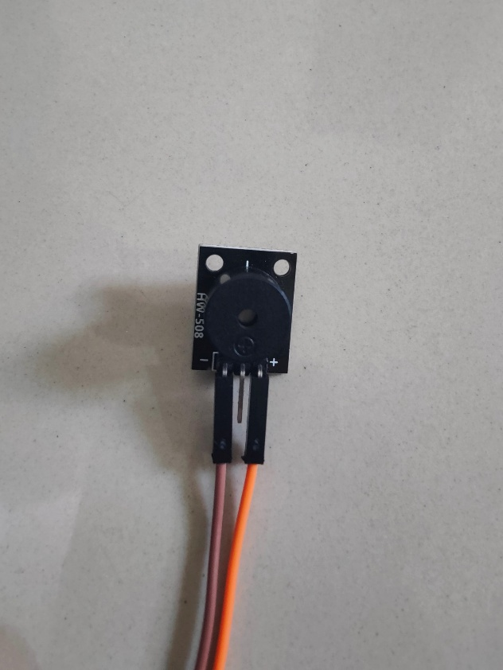
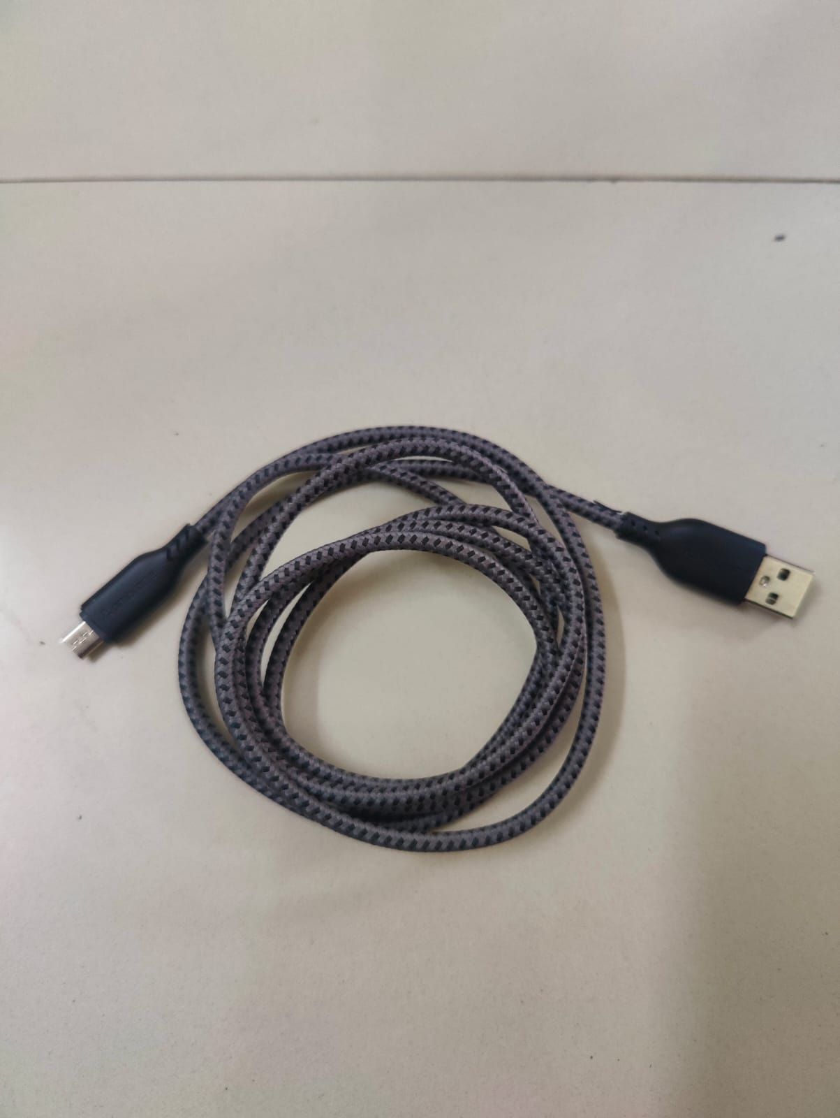
Nutan Maharashtra Vidya Prasarak Mandal's
NUTAN MAHARASHTRA INSTITUTE OF ENGINEERING & TECHNOLOGY, PUNE
Department of Computer Engineering
Buzzer
Jumper Cables
SPPU Project Work Stage – I, A.Y. 2024-25
https://www.nmiet.edu.in

Slide 28
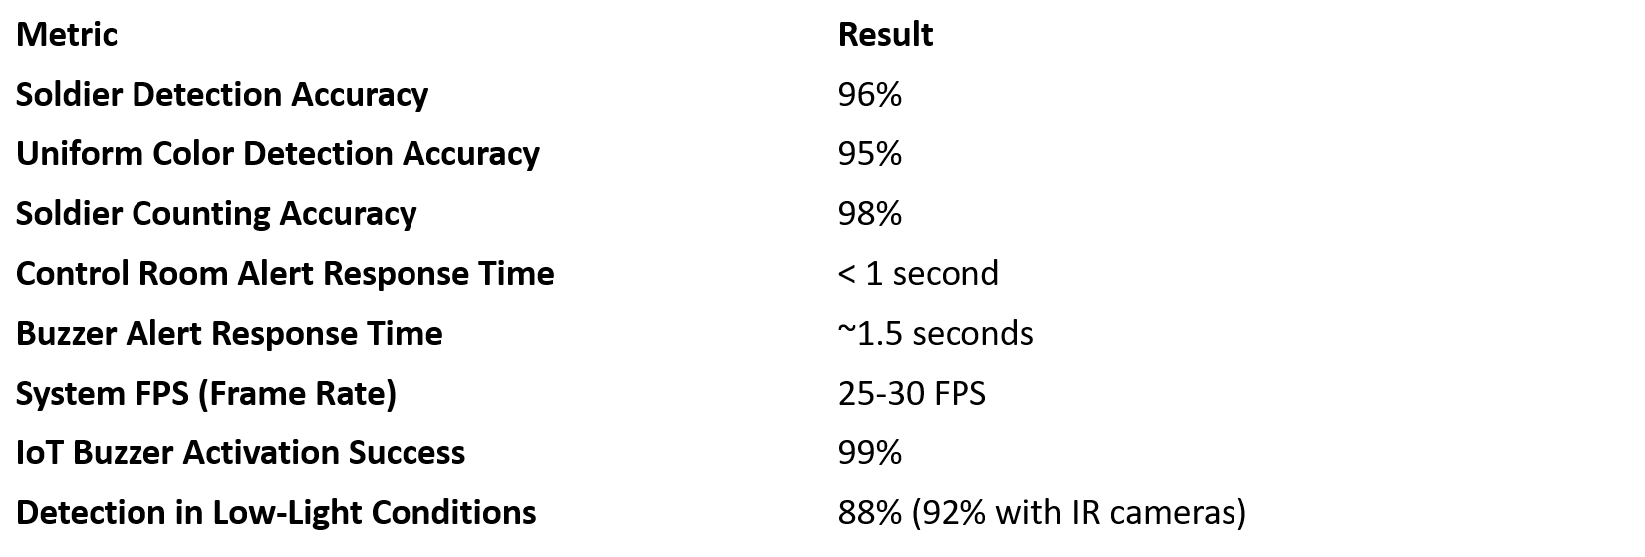
11. Project Testing Result
Nutan Maharashtra Vidya Prasarak Mandal's
NUTAN MAHARASHTRA INSTITUTE OF ENGINEERING & TECHNOLOGY, PUNE
Department of Computer Engineering
SPPU Project Work Stage – I, A.Y. 2024-25
https://www.nmiet.edu.in

Slide 29
12. Advantages
Nutan Maharashtra Vidya Prasarak Mandal's
NUTAN MAHARASHTRA INSTITUTE OF ENGINEERING & TECHNOLOGY, PUNE
Department of Computer Engineering
1. Enhanced Security:
- Provides real-time monitoring to detect unauthorized individuals, improving overall safety.
2. Automated Alerts:
- Sends immediate alerts to control systems, enabling quick responses to potential threats.
3. Operational Efficiency:
- Reduces the need for constant manual surveillance, allowing personnel to focus on critical tasks.
4. Scalability:
- Can be implemented in various settings, from small businesses to large institutions, adapting to
specific security needs.
5. Data Logging and Analysis:
- Stores event logs for future analysis, helping organizations identify trends and improve security protocols.
6. Cost-Effective:
- Minimizes losses from theft or security breaches, ultimately saving money on damages and insurance.
SPPU Project Work Stage – I, A.Y. 2024-25
https://www.nmiet.edu.in

Slide 30
13. Disadvantages
Nutan Maharashtra Vidya Prasarak Mandal's
NUTAN MAHARASHTRA INSTITUTE OF ENGINEERING & TECHNOLOGY, PUNE
Department of Computer Engineering
1. Privacy Concerns
-There may be potential backlash from staff, visitors, or the public regarding being monitored, which could affect trust.
2. Dependence on Technology
-The system's effectiveness relies heavily on the quality of the hardware (cameras, alarms) and software (detection algorithms).
-Any malfunction or technical failure could compromise security.
3. Cost of Implementation
-Setting up such a system can be expensive, including the costs of hardware (cameras, alarms), software development, and ongoing maintenance.
4. Complexity of Integration
-Integrating the system with existing security measures or infrastructure can be complicated.
SPPU Project Work Stage – I, A.Y. 2024-25
https://www.nmiet.edu.in

Slide 31
14. Conclusion
Nutan Maharashtra Vidya Prasarak Mandal's
NUTAN MAHARASHTRA INSTITUTE OF ENGINEERING & TECHNOLOGY, PUNE
Department of Computer Engineering
This project aims to create a robust and efficient system for detecting suspicious entities using IoT technology. By integrating machine learning and real-time monitoring, the system will provide enhanced security and help in preventing potential threats before they escalate.
SPPU Project Work Stage – I, A.Y. 2024-25
https://www.nmiet.edu.in

Slide 32
15. Future Scope
Nutan Maharashtra Vidya Prasarak Mandal's
NUTAN MAHARASHTRA INSTITUTE OF ENGINEERING & TECHNOLOGY, PUNE
Department of Computer Engineering
AI-Powered Threat Prediction: Advanced AI models are used, the system could analyse patterns to predict potential security threats, allowing for actions and more active security measures.
Enhanced Integration with IoT Devices: Expanding the use of IoT devices, such as drones, sensors, and wearable tech for personnel, would provide broader coverage, improved situational awareness, and the ability to monitor larger areas in real time.
Improved Accuracy through Deep Learning Advancements: As deep learning models continue to evolve, future updates could improve detection accuracy, even in challenging conditions like low lighting, crowds, or varying weather, enhancing the system's reliability.
Facial Recognition and Biometric Authentication: Adding facial recognition or other biometric methods could further enhance identification accuracy, allowing the system to verify personnel and differentiate between authorized and unauthorized individuals
SPPU Project Work Stage – I, A.Y. 2024-25
https://www.nmiet.edu.in

Slide 33
16. References
Nutan Maharashtra Vidya Prasarak Mandal's
NUTAN MAHARASHTRA INSTITUTE OF ENGINEERING & TECHNOLOGY, PUNE
Department of Computer Engineering
https://ieeexplore.ieee.org/document/9003336
https://www.researchgate.net/publication/337800208
https://ar5iv.labs.arxiv.org/html/1804.02767
https://www.journalofcomputervision.com/
https://ijcai.org/
SPPU Project Work Stage – I, A.Y. 2024-25
https://www.nmiet.edu.in

Slide 34
16. References
Nutan Maharashtra Vidya Prasarak Mandal's
NUTAN MAHARASHTRA INSTITUTE OF ENGINEERING & TECHNOLOGY, PUNE
Department of Computer Engineering
[1]. Chen, J., & Wu, Y. (2021). IoT-Based Real-Time Monitoring System for Smart Cities.
IEEE Internet of Things Journal, 8(2), 1567-1574.
[2]. Han, S., Kang, J., & Choi, K. (2020). Real-Time Surveillance System using Deep Learning Techniques. Journal of Surveillance Security Research, 42(4), 124-131.
[3]. Xu, G., Zhang, S., Wang, X., Wang, J., & Wu, Y. (2020). Real-Time Object Detection Based on YOLO and Cloud Computing. International Journal of Computer Applications, 42(3), 77-85.
[4]. Smith, R., & White, T. (2019). Ethics and Privacy Concerns in Surveillance Systems.
Journal of Security and Privacy Research, 30(2), 201-215.
[5]. Redmon, J., & Farhadi, A. (2018). YOLOv3: An Incremental Improvement. arXiv preprint arXiv:1804.02767.
SPPU Project Work Stage – I, A.Y. 2024-25
https://www.nmiet.edu.in

Slide 35
Nutan Maharashtra Vidya Prasarak Mandal's
NUTAN MAHARASHTRA INSTITUTE OF ENGINEERING & TECHNOLOGY, PUNE
Department of Computer Engineering
[6] GLAMSTORM. A virtual stylist as a bridge between the virtual and the real fashion world, 2017.
[7] Xianwang Wang and Tong Zhang. Clothes search in con sumer photos via color matching and attribute learning. In Proceedings of the 19th ACM international conference on Multimedia, pages 1353–1356. ACM, 2011.
[8] Huizhong Chen, Andrew Gallagher, and Bernd Girod. De scribing clothing by semantic attributes. In European con ference on computer vision, pages 609 623. Springer, 2012.
[9] Shuai Zheng, Fan Yang, M Hadi Kiapour, and Robinson Pi ramuthu. Modanet: A large-scale street fashion dataset with polygon annotations. In 2018 ACM Multimedia Conference on Multimedia Conference, pages 1670–1678. ACM, 2018.
SPPU Project Work Stage – I, A.Y. 2024-25
https://www.nmiet.edu.in

Slide 36
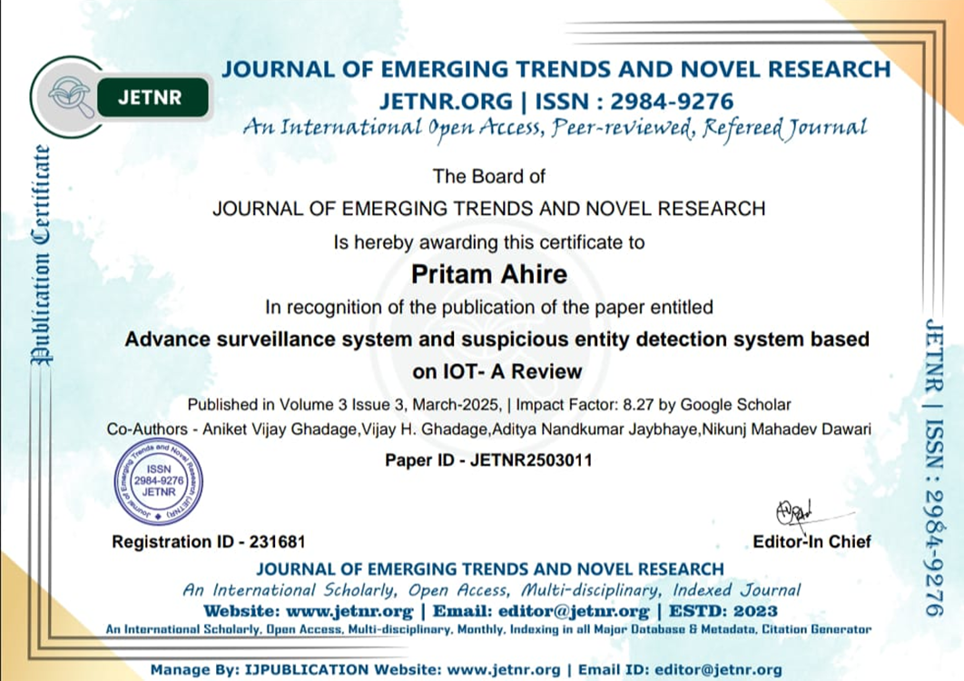
Certificates:
Nutan Maharashtra Vidya Prasarak Mandal's
NUTAN MAHARASHTRA INSTITUTE OF ENGINEERING & TECHNOLOGY, PUNE
Department of Computer Engineering
SPPU Project Work Stage – I, A.Y. 2024-25
https://www.nmiet.edu.in

Slide 37
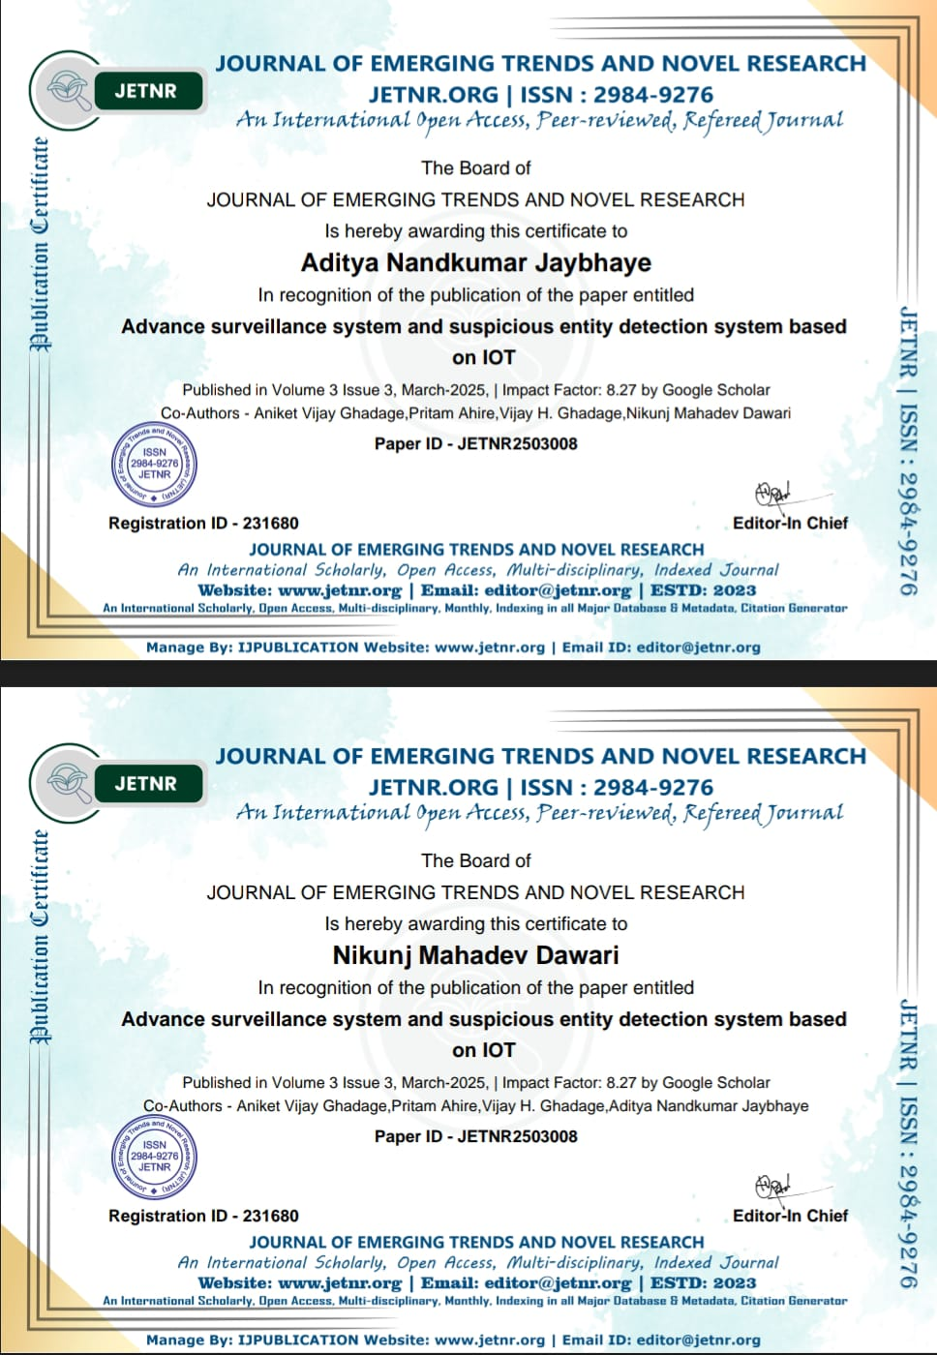
Nutan Maharashtra Vidya Prasarak Mandal's
NUTAN MAHARASHTRA INSTITUTE OF ENGINEERING & TECHNOLOGY, PUNE
Department of Computer Engineering
SPPU Project Work Stage – I, A.Y. 2024-25
https://www.nmiet.edu.in

Slide 38
Nutan Maharashtra Vidya Prasarak Mandal's
NUTAN MAHARASHTRA INSTITUTE OF ENGINEERING & TECHNOLOGY, PUNE
Department of Computer Engineering
SPPU Project Work Stage – I, A.Y. 2024-25
https://www.nmiet.edu.in

Slide 39
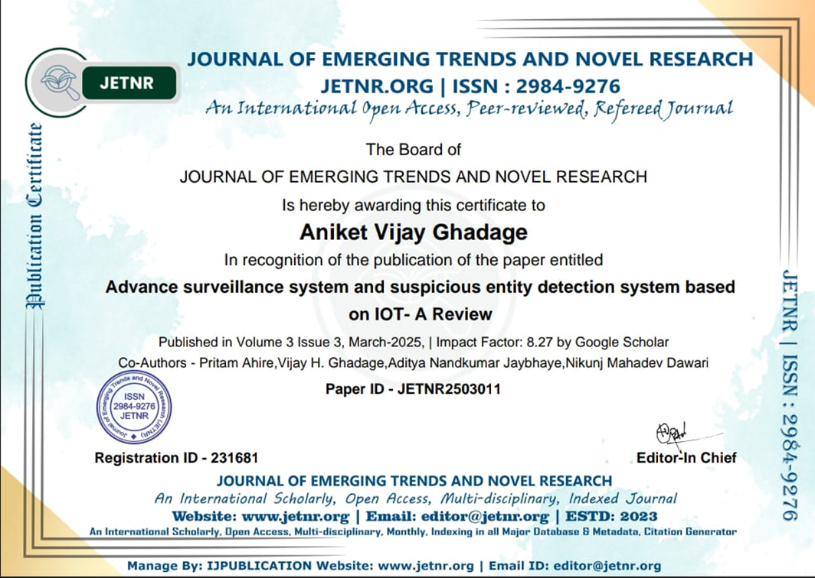
Nutan Maharashtra Vidya Prasarak Mandal's
NUTAN MAHARASHTRA INSTITUTE OF ENGINEERING & TECHNOLOGY, PUNE
Department of Computer Engineering
SPPU Project Work Stage – I, A.Y. 2024-25
https://www.nmiet.edu.in

